Slide 1
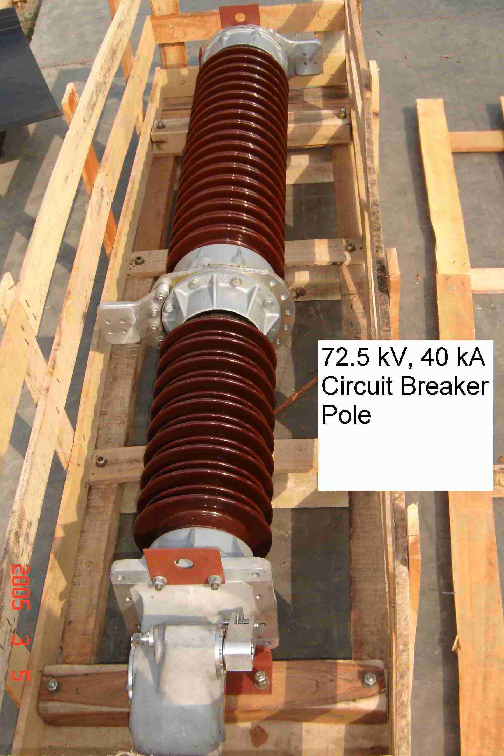
SIEMENS
HVCB SPARES
Complete Pole of CB
72.5KV, 40KA CB
S4799206001

